Slide 1
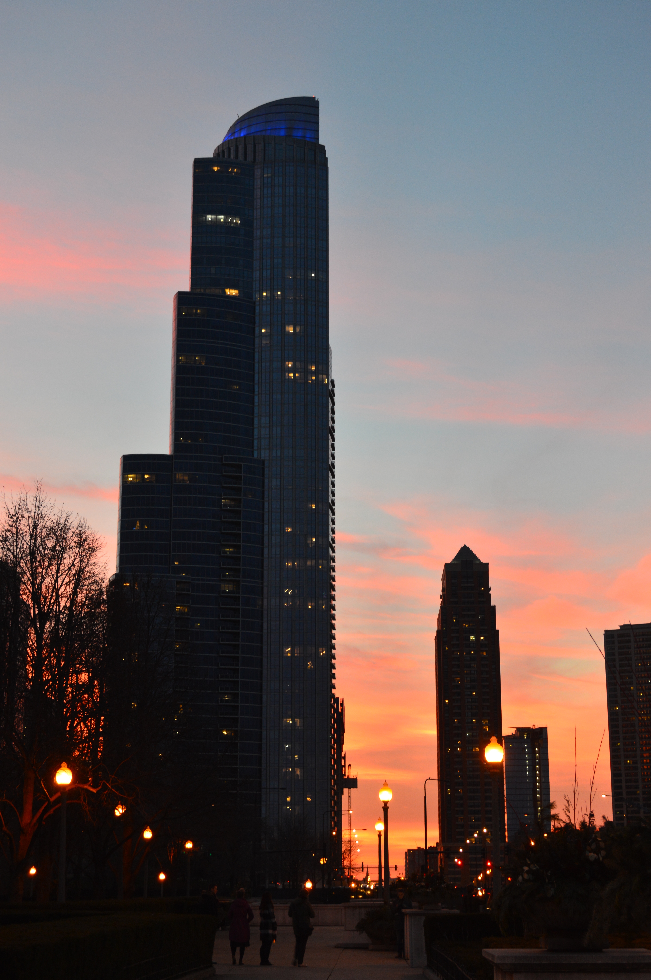
Theme Based Aesthetic Image Assessment
Amritbani Sondhi, Pratheek Gowda
CIS 700 - Machine Learning and Security, Spring 2018

Slide 2
Problem Statement
Quantification of image quality and aesthetics while addressing the subjective nature of image quality for specific classes of images, such as portraits, wild life, cityscapes.

Slide 3
Previous Work
R. Datta et. al (2006)
Visual Features
Machine Learning using SVMs and Linear Regression
RAPID model (2014)
Generic Convolutional Neural Network
Style annotations
DCM model (2017)
Parallel supervised pathways for feature extraction
High-level synthesis network for overall aesthetics rating prediction

Slide 4
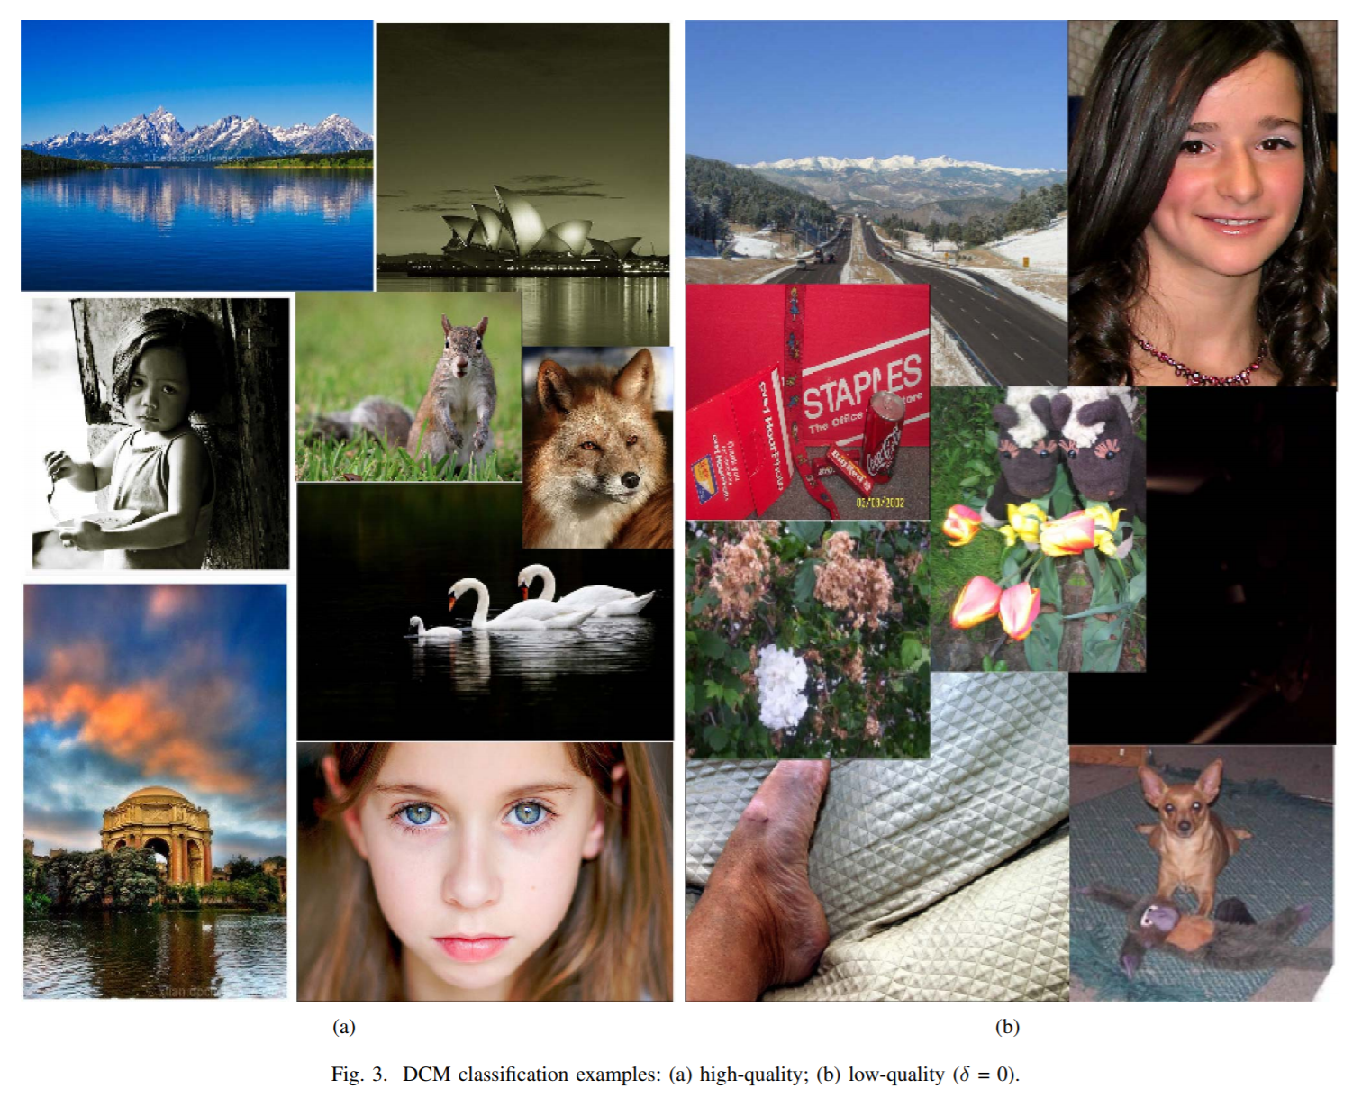
Aim
Source:
“Image Aesthetics Assessment using Deep Chatterjee’s Machine” [1] - Z. Wang, D. Liu, S. Chang, F. Dolcos, D. Beck, and T. Huang

Slide 5
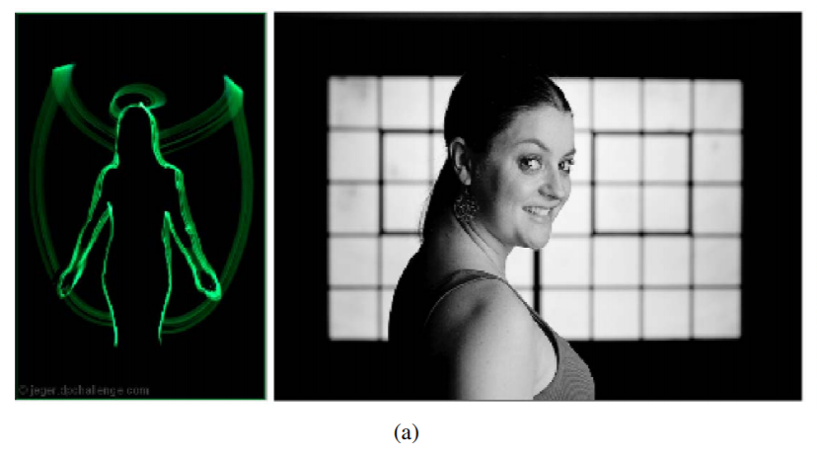
Issues
Contexts and emotions could alter the aesthetics judgment
Source:
“Image Aesthetics Assessment using Deep Chatterjee’s Machine” [1] - Z. Wang, D. Liu, S. Chang, F. Dolcos, D. Beck, and T. Huang

Slide 6


Our Dataset
Contexts and emotions could alter the aesthetics judgment
a) Light Painting
b) City of Stars

Slide 7
Our Work
Planning
Theme detection and classification.
Assessment of the images according to its theme.
Machine Learning Approach
Features – RGB, Motion Blur, Image Grain.
Using Neural Network
Feature Learning using Tensor flow.
Theme Classification.

Slide 8
Means and Modules
Theme Classification
Tensor flow
OpenCV
Keras
Aesthetic Rating
MobileNet
Inception V3

Slide 9
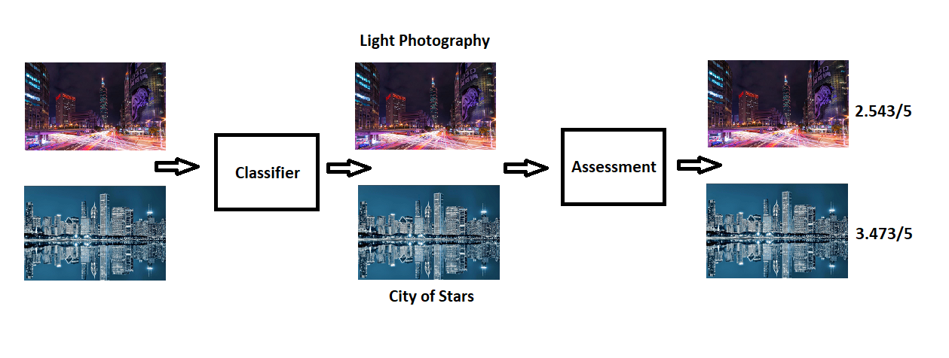
Model

Slide 10
Progress
Initiated with feature extractions with OpenCV
Trained a basic machine learning model for classification
Created a separate dataset with specific related themes
City of Stars, Stars, Light Photography, Cityscapes
Created TensorRecords for loading raw dataset
Trying to set in suitable hyper-parameters for tensor flow model

Slide 11
Challenges
Understanding image features that are contributing towards aesthetic beauty.
Extracting image features from the collected data.
OpenCV
Creating Dataset.
Understanding Keras and Tensor flow.

Slide 12
To-Do
Use various models for image assessment
Comparing various models
Comparing various themes and accuracies

Slide 13
References
[1] Z. Wang, D. Liu, S. Chang, F. Dolcos, D. Beck, and T. Huang, “Image Aesthetics Assessment using Deep Chatterjee’s Machine” in International Joint Conference on Neural Networks (IJCNN), Anchorage, AK, 2017, pp. 941-948.
[2] X. Liu, Z. Lin, H. Jin, J. Yang and J. Z. Wang, “RAPID: Rating pictorial aesthetics using deep learning” in Proceedings of the ACM International Conference on Multimedia. ACM, 2014, pp. 457-466.
[3] R. Datta, D. Joshi, J. Li, and J. Z. Wang, “Studying aesthetics in photographic images using a computational approach”, in Computer Vision- EECV 2006. Springer, 2006, pp. 288-301.
[4] Introducing NIMA: Neural Image Assessment-2017. Posted by Hossein Talebi, Software Engineer and Peyman Milanfar Research Scientist, Machine Perception.
[5] R. Arnheim, “Art and Visual Perception: A Psychology of the Creative Eye”, University of California Press, Berkeley, 1974.

